Slide 1
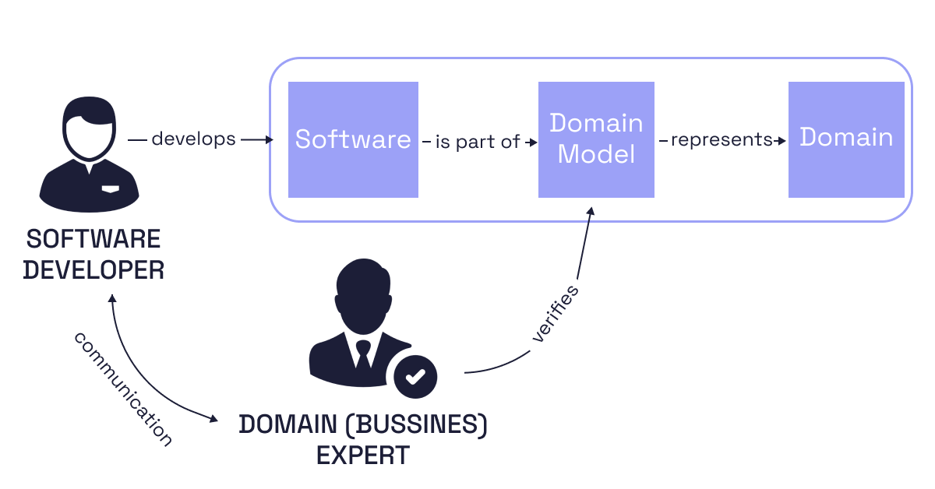
The CPSA® Advanced Level Module DDD
Day 1: Foundations - Domain, Model & Ubiquitous Language
iSAQB® Training Course in Domain-Driven Design
22 December 2025
VOLKSWAGEN GROUP INDIA

Slide 2






Course Overview: 6-Day Training Journey
Day 1
Day 2
Day 3
Day 4
Day 5
Day 6
Foundations
Knowledge Crunching
Implementation
Architecture
Strategic Design 1
Strategic Design 2
Domain, Model & Ubiquitous Language
From Model to Technical Implementation
Model in Application Architecture
Cutting and Distinguishing Models
Context Mapping & Integration
Collaborative Modeling with Domain Experts
22 Dec 2025
05 Jan 2026
06 Jan 2026
07 Jan 2026
08 Jan 2026
09 Jan 2026
The CPSA® Advanced Level Module DDD – iSAQB® Training Course
Volkswagen Group India

Slide 3






Day 1 Agenda: Foundations - Domain, Model & Ubiquitous Language
Introduction to DDD
DDD Building Blocks
What is Domain-Driven Design and why it matters for automotive
Entities, Value Objects, Aggregates, Services, Repositories, Factories
Domains, Software & Models
Understanding connections between business domains and software
Automotive Applications
Applying DDD concepts to powertrain, infotainment, and safety systems
Ubiquitous Language
Creating shared vocabulary between domain experts and developers
Hands-on Activities
Domain modeling exercises and mini-project
The CPSA® Advanced Level Module DDD – iSAQB® Training Course
Volkswagen Group India | 22 December 2025

Slide 4
Learning Goals: Day 1
1-1
Domain Connections
Explain connections between domains, software, and models
1-2
Ubiquitous Language
Understand role of ubiquitous language in domain modeling
1-3
DDD Building Blocks
Explain DDD building blocks (Entities, Value Objects, Aggregates)
1-4
Block Connections
Explain connections between building blocks
The CPSA® Advanced Level Module DDD – iSAQB® Training Course
Volkswagen Group India | 22 December 2025

Slide 5






What is Domain-Driven Design?
DDD Concept
Why for Automotive?
Strategic Approach
Software Complexity
Design software as precise, transparent, and transformable representation of business domain
Modern vehicles contain 100+ million lines of code across multiple domains
Shared Understanding
Multiple Domains
Creates common language between domain experts and developers
Infotainment, safety, powertrain, connectivity, autonomous driving
Cross-Team Collaboration
"Domain-Driven Design tackles complexity at the heart of software, focusing on the core domain and its logic."
Different teams work on interconnected vehicle subsystems
100M+
150+
5+
Lines of Code
ECUs in Premium Vehicles
Software Domains
The CPSA® Advanced Level Module DDD – iSAQB® Training Course
Volkswagen Group India | 22 December 2025

Slide 6









LG 1-1: Connections between Domains, Software, and Models
Core Concepts
Automotive Application
Domain
Sphere of knowledge, activity, or influence
Powertrain Domain
Software
Domain: Engine components, fuel systems, transmission
Implementation that serves the domain
Model: Engine class, FuelSystem class, Transmission class
Model
Abstraction of domain concepts
Software: Powertrain control module implementation
Domain
Model
Software
Key Principle
Software must serve the domain, not the other way around
The CPSA® Advanced Level Module DDD – iSAQB® Training Course
Volkswagen Group India | 22 December 2025

Slide 7







LG 1-2: Role of Ubiquitous Language in Domain Modeling
Ubiquitous Language
Automotive Application
Common Terminology
Shared vocabulary between domain experts and developers
Infotainment System
Terms: MediaSource, Playlist, NavigationRoute
Bridge Communication
Consistent: Used in discussions, code, and documentation
Eliminates translation between business and technical teams
Living Documentation
Language evolves with domain understanding
Powertrain Domain
Terms: TorqueCurve, GearRatio, ThrottlePosition
Domain Experts
Ubiquitous Language
Developers
Precise: Clear meaning for engineers and developers
The CPSA® Advanced Level Module DDD – iSAQB® Training Course
Volkswagen Group India | 22 December 2025

Slide 8






LG 1-3: DDD Building Blocks
Entity
Value Object
Aggregate
Objects with distinct identity that track state over time
Immutable objects defined by attributes, not identity
Cluster of related objects treated as a single unit
Automotive Example: Vehicle, Customer, Order
Automotive Example: VIN, Speed, Temperature
Automotive Example: Vehicle with Components
Service
Repository
Factory
Stateless operations that don't naturally fit entities
Mediates between domain and data mapping layers
Encapsulates complex object creation logic
Automotive Example: PaymentProcessor, DiagnosticService
Automotive Example: VehicleRepository, CustomerRepository
Automotive Example: VehicleFactory, OrderFactory
The CPSA® Advanced Level Module DDD – iSAQB® Training Course
Volkswagen Group India | 22 December 2025

Slide 9



LG 1-4: Connections between Building Blocks
Key Relationships
Automotive Example
Aggregates Contain
Vehicle Aggregate
Aggregates contain Entities and Value Objects
Entity: Vehicle (with unique VIN)
Repositories Manage
Value Objects: Speed, Temperature, FuelLevel
Repositories manage Aggregates
Service: DiagnosticService (stateless)
Factories Create
Factories create complex Entities and Aggregates
Factory
Aggregate
Vehicle Factory
Creates Vehicle with proper validation
Repository
Aggregate
VehicleRepository persists and retrieves
The CPSA® Advanced Level Module DDD – iSAQB® Training Course
Volkswagen Group India | 22 December 2025

Slide 10




Key Concepts with Automotive Examples
Vehicle Domain
Infotainment System
Powertrain Domain
Entity: Vehicle with unique VIN
Entity: MediaSession, NavigationRoute
Entity: Engine, Transmission
Value Object: LicensePlate, Color
Value Object: TorqueCurve, GearRatio
Value Object: MediaSource, Coordinates
Aggregate: Vehicle with Components
Factory: PowertrainFactory
Service: MediaStreamingService
Ubiquitous Language: ThrottlePosition, FuelInjection
Repository: VehicleRepository
Ubiquitous Language: Playlist, Route, VoiceCommand
The CPSA® Advanced Level Module DDD – iSAQB® Training Course
Volkswagen Group India | 22 December 2025

Slide 11



Activities & Exercises
Define Automotive Domain Boundaries
1
Identify key domains in vehicle systems
2
Define scope and boundaries
3
Map interactions between domains
Create Ubiquitous Language
1
Gather domain terminology
2
Create shared vocabulary
3
Define glossary for vehicle systems
Model Domain Concepts
1
Identify entities and value objects
2
Group into aggregates
3
Create class diagrams
The CPSA® Advanced Level Module DDD – iSAQB® Training Course
Volkswagen Group India | 22 December 2025

Slide 12






Mini-Project: Automotive Domain Model
Project Steps
Example: Infotainment System
1
Define Domain
Entities
Choose an automotive domain (e.g., infotainment, powertrain, safety)
MediaSession (unique ID)
NavigationRoute (unique ID)
2
Identify Building Blocks
List entities, value objects, and aggregates
Value Objects
MediaSource (attributes only)
3
Create Ubiquitous Language
Coordinates (attributes only)
Define shared terminology for domain concepts
Ubiquitous Language
4
Model Relationships
Playlist, Route, VoiceCommand, MediaControl
Show connections between building blocks
The CPSA® Advanced Level Module DDD – iSAQB® Training Course
Volkswagen Group India | 22 December 2025

Slide 13










Resources & Tools
Learning Platforms
Modeling Tools
Books & Blogs
DDD-Crew
PlantUML
Domain-Driven Design
Free resources, patterns, and examples
Text-based UML diagrams for domain models
Eric Evans - The foundational DDD book
Domain-Driven Design Weekly
Miro
Vaughn Vernon's Blog
Weekly video series on DDD concepts
Collaborative whiteboard for modeling
Practical DDD implementation strategies
DDD Community
Discussions, Q&A, and case studies
EventStorming.com
DDD in Practice
Tools and techniques for event storming
Real-world case studies and patterns
The CPSA® Advanced Level Module DDD – iSAQB® Training Course
Volkswagen Group India | 22 December 2025

Slide 14











Connecting to Day 2
Day 2: 05 January 2026
Day 2 Topics
Review Before Day 2
Knowledge Crunching
Key Concepts
Working with domain experts to extract knowledge
Ubiquitous Language principles
Building Blocks relationships
Automotive domain examples
Collaborative Modeling
EventStorming, Domain Storytelling, User Story Mapping
Self-Study Materials
EventStorming guide
Knowledge Elicitation
Collaborative modeling videos
Interviewing, observation, field observation, apprenticing
DDD community discussions
The CPSA® Advanced Level Module DDD – iSAQB® Training Course
Volkswagen Group India | 22 December 2025

Slide 15


Summary & Q&A
Day 1 Key Points
Domain-Driven Design creates precise, transparent representations of business domains
Ubiquitous Language bridges communication between domain experts and developers
Questions & Discussion
Let's clarify any concepts and discuss how DDD applies to your specific automotive projects at Volkswagen
Building Blocks (Entities, Value Objects, Aggregates) form the foundation of DDD
DDD helps manage automotive complexity across multiple vehicle systems
The CPSA® Advanced Level Module DDD – iSAQB® Training Course
Volkswagen Group India | 22 December 2025

